Slide 1

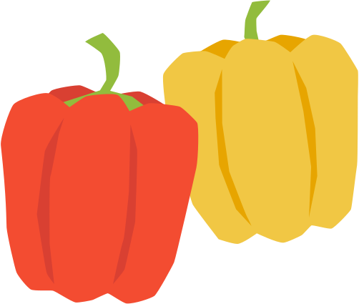

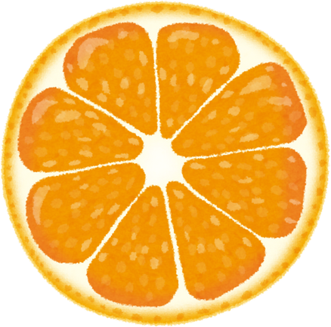

2026逗深坑餐旅創意行銷競賽
主題
參賽者資料

Slide 2


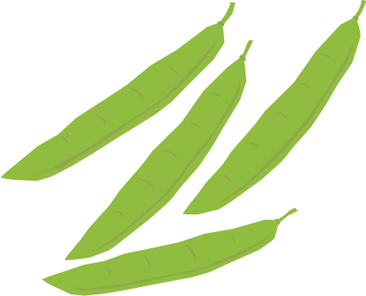

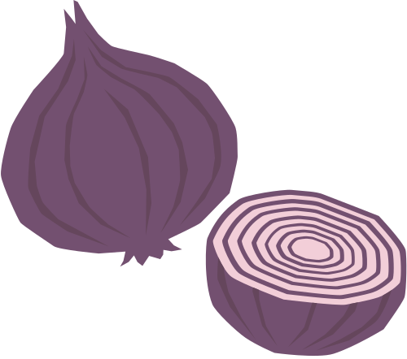
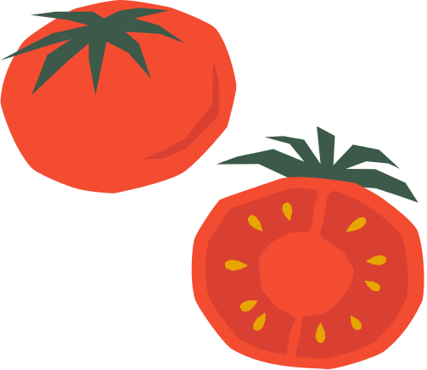

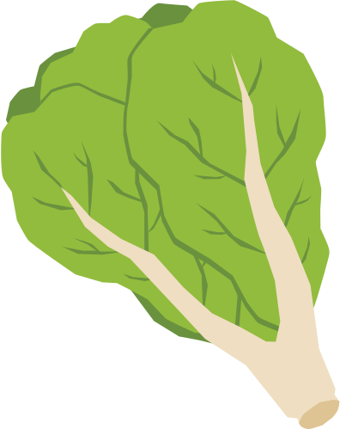
背景介紹

Slide 3

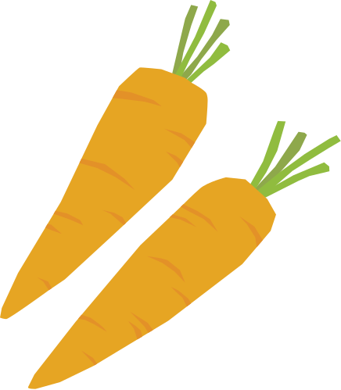
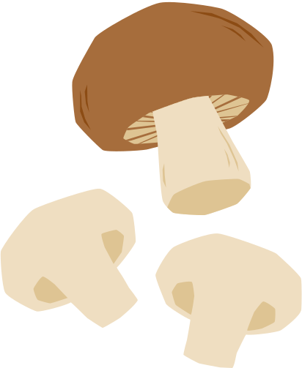
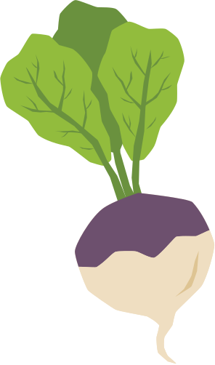

創作靈感與理念

Slide 4
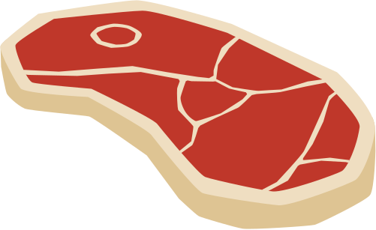

創意賣點

Slide 5
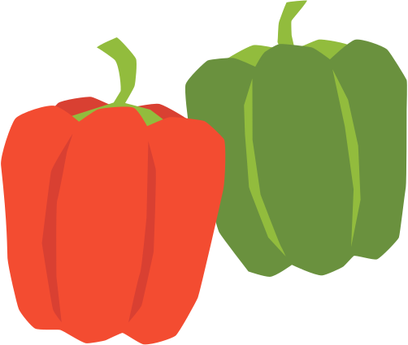
料理介紹
Different cooking methods bring out unique flavors. Roasting intensifies sweetness, grilling adds smokiness, and steaming preserves nutrients. Choosing the right technique is key to perfecting any recipe.

Slide 6

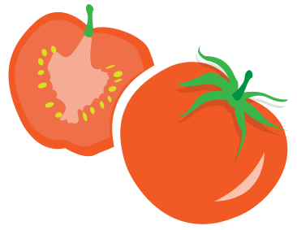

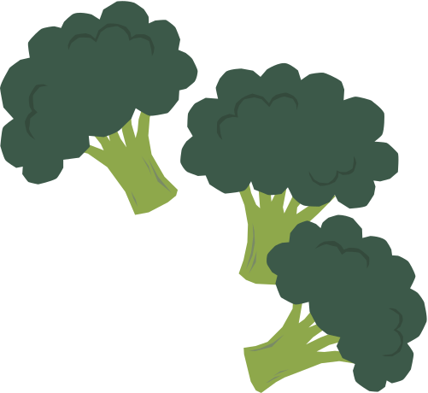

視覺呈現

Slide 7
成本分析與定價
Texture makes food exciting. Combining crunchy, creamy, chewy, and smooth elements creates contrast and enhances enjoyment. A crispy topping on a soft dish or a creamy sauce with grilled food adds appeal.

Slide 8

市場推廣策略

Slide 9
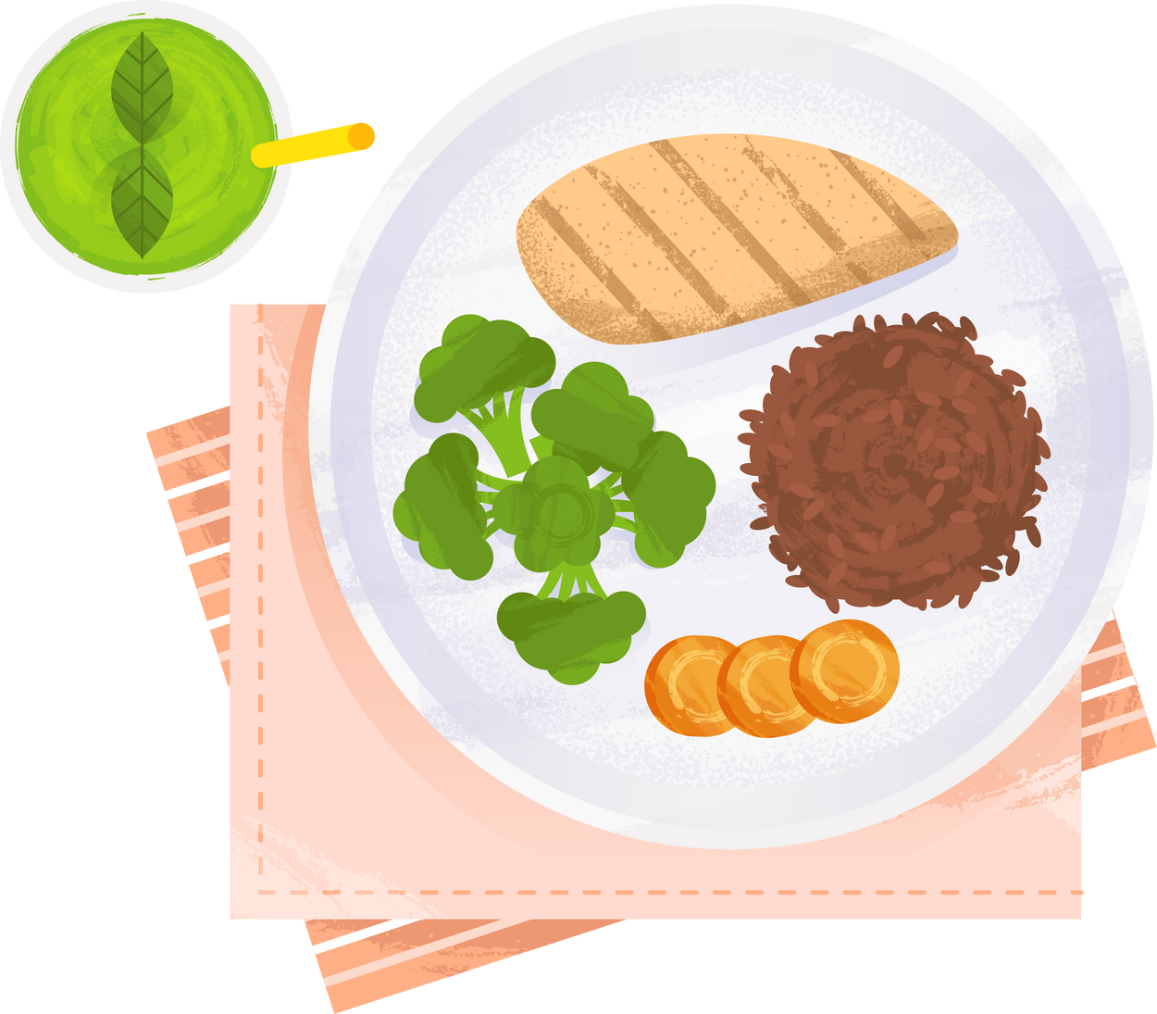

預算效益

Slide 10
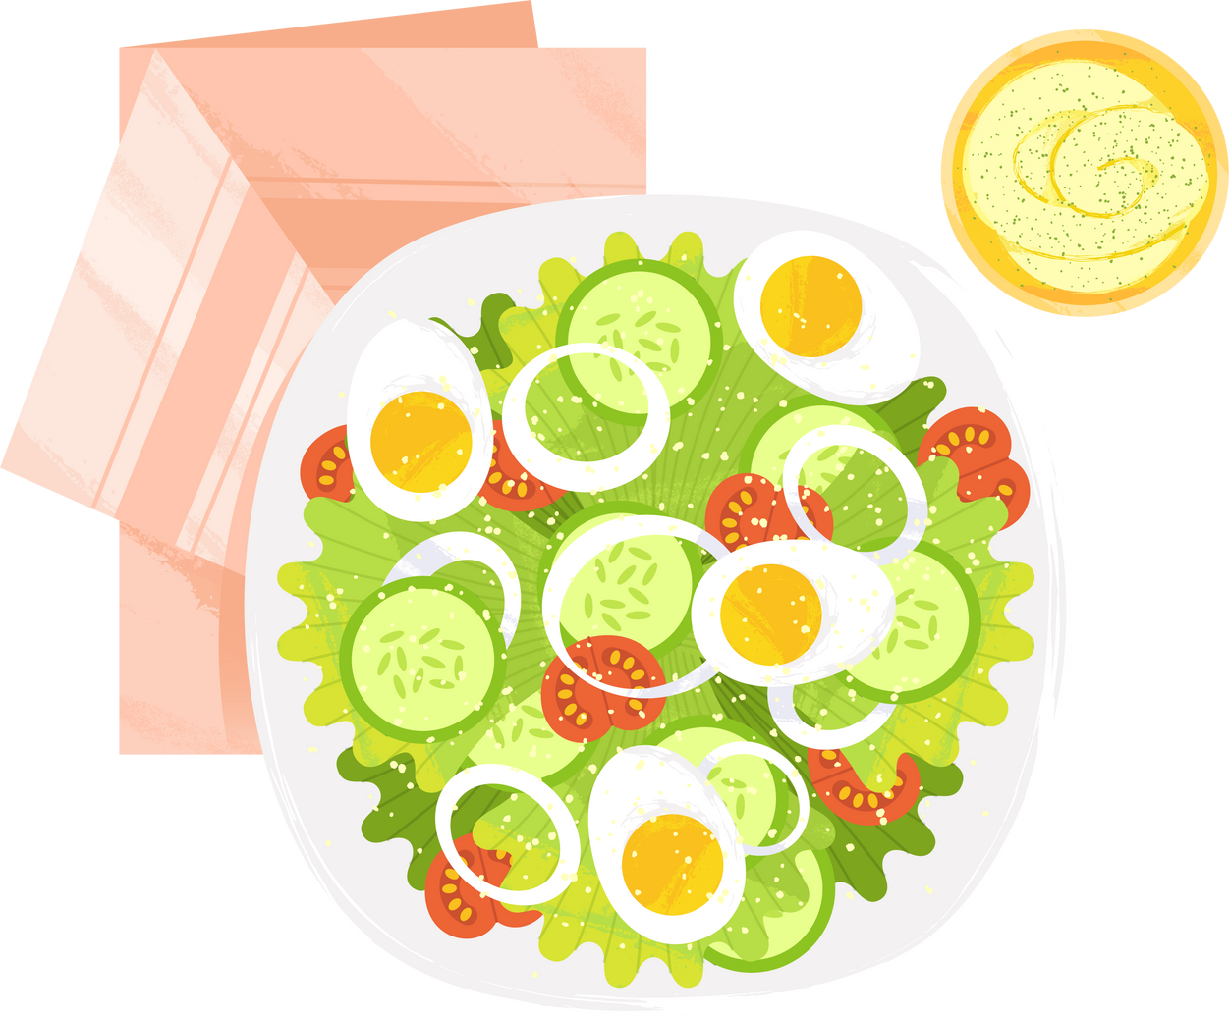
結語與願景

